Slide 1

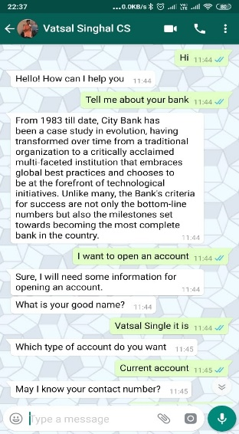
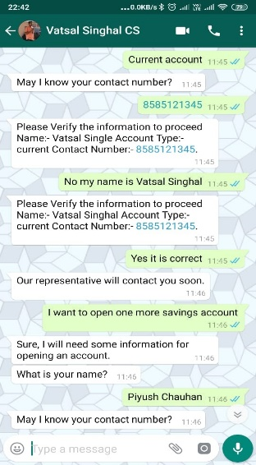
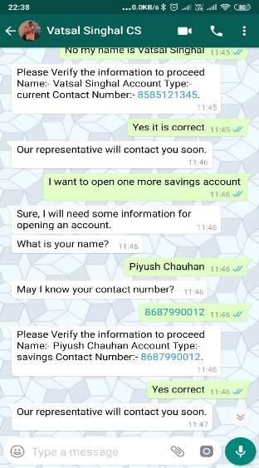
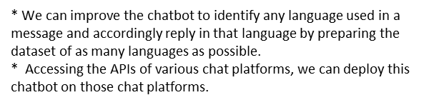
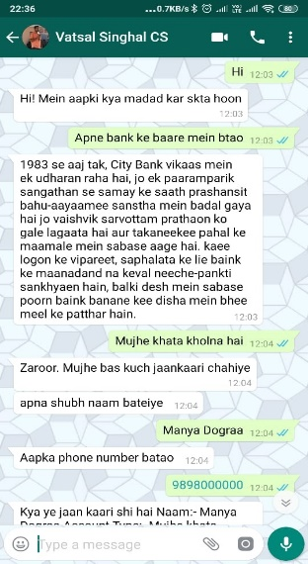
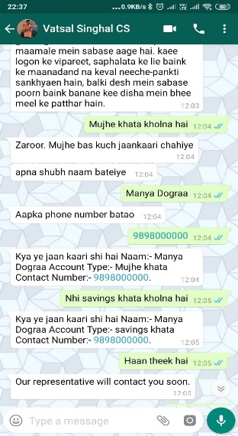
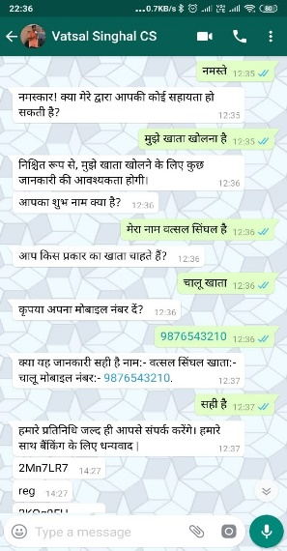
Multilingual Chatbot
Astha Singhal | Khushi Prasad | Kalpana Bishnoi Indian Institute of Technology Patna
Abstract
Methodology
The term “chatbot” comes from “chatterbot” coined by Michael Mauldin in 1994.
The first ever chatbot was introduced even before the launch of personal computer. It was first developed by Joseph Weizenbawn in 1966.
Chatbot is the new form of storytelling by being available to the customers at the right time and place with right information.
In the present time chatbots are more beneficial to improve efficacy and productivity by providing quick answers and solutions to customers.
Chatbot has reduced operational costs, manpower and time.
According to chatbot report 2019:Global Trends and Analysis and according to Lauren Foye, by 2022, banks can automate up to 90% of their customer interaction using chatbots.
Customer inputs message on the chat platform
Selenium bot detects the message and transfer it to RASA via flask API.
(INSIDE RASA SDK)
Generation of a suitable response using NLP.
Language and Intent classification using language classification and intent classification algorithms respectively.
Most of the chatbot can converse in English only. Multilingual chatbot that can interact with customers in their local language.
After preparing dataset for a particular language, the bot will recognized and respond in that language.
Multilingual chatbot has the specialty to recognize and answer in “Hindi written in English” language as well, which gives a human like experience to the customers.
This chatbot also has the specialty to respond in the language used by the customers and is able to ask and tell information as require based on the what person messages.
Details of customers (as in case of bank accounts) gets automatically stored in the database of chatbot.
The generated message is transferred to Selenium bot via flask API.
(INSIDE RASA SDK)
The output message is displayed on the chat platform
Test Results
Conclusion
English Conversation
Businesses can use this chatbot in place of assigning employees to chat with the customer.
* Scalability - This chatbot can be deployed on any chat platform(provided that we have the API of the chat platform)for as many number of users as we want.
* Waiting time of customers reduced to NIL - Send responses to the customers quickly within a second.
* Flexibility of time - As a benefit of automation, the chatbot can answer questions 24x7.
* Fuel saving - Being available to the customer everywhere
Hinglish Conversation Hindi Conversation
References
SDK for the development of custom actions for Rasa - http://rasa.com/docs
The rasa client can be configured to do call back - this module process those requests- https://rasa.com/docs/rasa/user-guide/connectors/your-own-website/#rest-channels
RasaSDK.Model.Channel used for the communication if you are talking to something that requires different output formats
For version 2.0 of Rasa Open Source.- https://rasa.com/docs/rasa/pages/http-api
API reference - https://hexdocs.pm/rasa_sdk/api-reference.html

